Slide 1

Constructive alignment in practice: designing rating scales
CEFR Companion Volume implementation toolbox
Boîte à outils pour la mise en œuvre du volume complémentaire du CECR

Slide 2
Rating scales are key to ensure:
Validity
Reliability
Feedback for improvement
A common framework

Slide 3
Rating scales are key to ensure:
Validity
Reliability
Feedback for improvement
A common framework
Validity: the extend to which the test used measures what is intended to measure

Slide 4
Rating scales are key to ensure:
Validity
Reliability
Feedback for improvement
A common framework
Reliability: Reliability in language testing refers to the degree to which a language test consistently and accurately measures the language skills or abilities it is designed to assess.

Slide 5
Rating scales are key to ensure:
Validity
Reliability
Feedback for improvement
A common framework
A good rating scale allows for meaningful feedback to test takers. Clear and specific descriptors at different proficiency levels help candidates understand their strengths and weaknesses, enabling them to focus on areas that need improvement.

Slide 6
Rating scales are key to ensure:
Validity
Reliability
Feedback for improvement
A common framework
A good rating scale allows for standardization in language assessment. It provides a common framework that all assessors can follow, ensuring that candidates are evaluated consistently across different contexts and exam administrations.

Slide 7
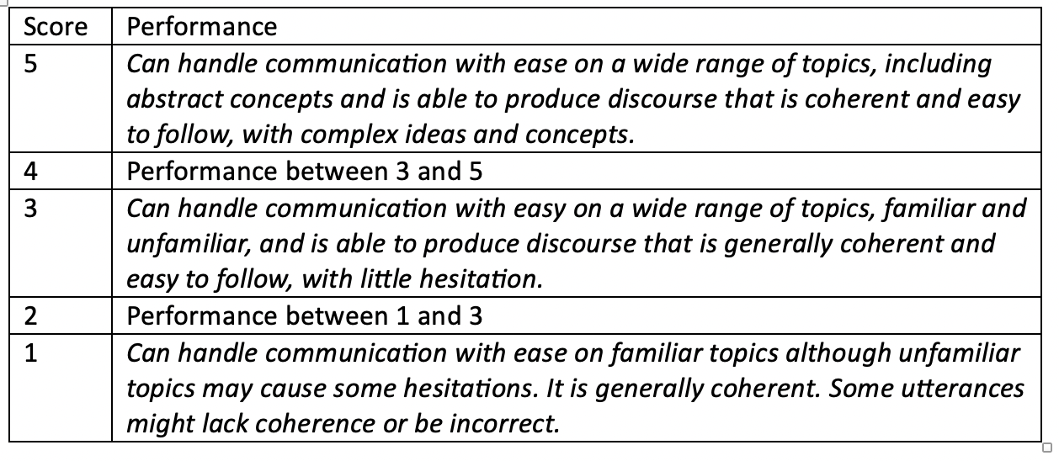
Most common types of rating scales
Holistic rating scale

Slide 8
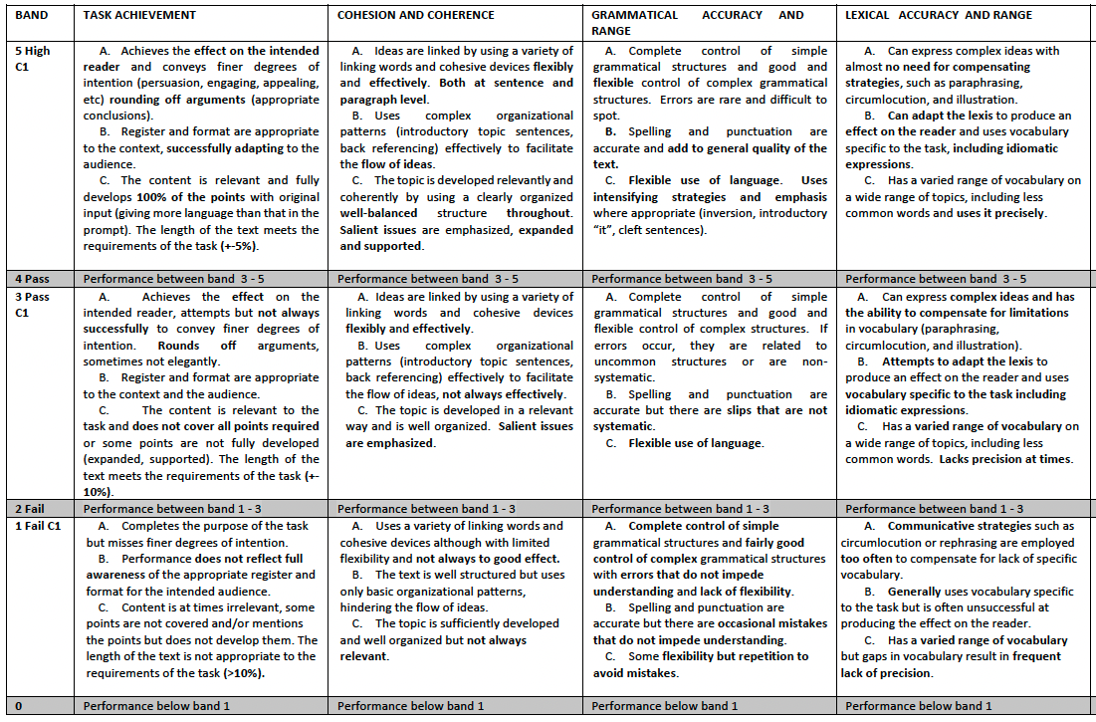
Most common types of rating scales
Analytic rating scale

Slide 9
Characteristics of the scales: which type to choose
Holistic rating scale: authentic, allows for faster rating processes, performs well for experienced or highly trained raters.
Analytic rating scale: reliable, richer information for test takers, suitable for novice raters.

Slide 10
Deciding on the type of scale
Purpose of our assessment
Type/s of tasks that will be assessed
Profile of raters
Feedback to students
Practicality (resources)

Slide 11
What tools can we use?
CEFR (Council of Europe 2001): https://rm.coe.int/1680459f97
CEFR Companion Volume (2020): https://rm.coe.int/common-european-framework-of-reference-for-languages-learning-teaching/16809ea0d4
Relating Language Examinations to the Common European Framework of Reference for Languages. A Manual (Council of Europe): https://rm.coe.int/CoERMPublicCommonSearchServices/DisplayDCTMContent?documentId=0900001680667a2d
Reference Supplement to the Manual for Relating Language examinations to the CEFR: https://www.coe.int/en/web/common-european-framework-reference-languages/additional-material#Reference

Slide 12
What tools can we use?
Illustrations of the European levels of language proficiency: https://www.coe.int/en/web/common-european-framework-reference-languages/additional-material
Manual for Language Test Development and Examining for Use with the CEFR (2011): https://rm.coe.int/CoERMPublicCommonSearchServices/DisplayDCTMContent?documentId=0900001680667a2b
Guidelines for Language for Specific Purposes Test Development (2018):
https://www.alte.org/resources/Documents/6093%20LSP%20Supplement%20-%20WEB.pdf

Slide 13
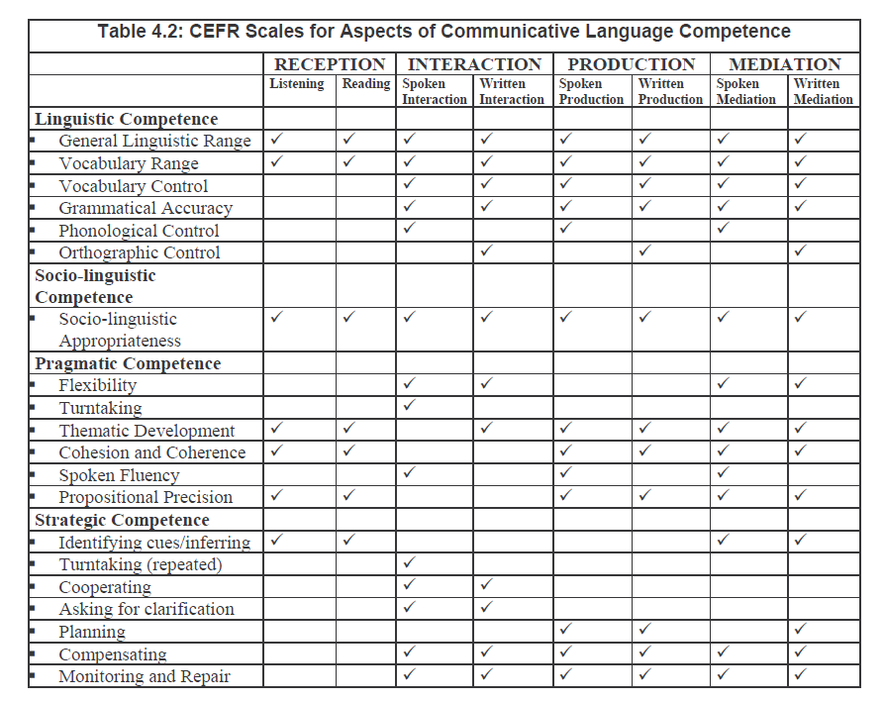
Relating Language Examinations to the Common European Framework of Reference for Languages. A Manual: Scales

Slide 14
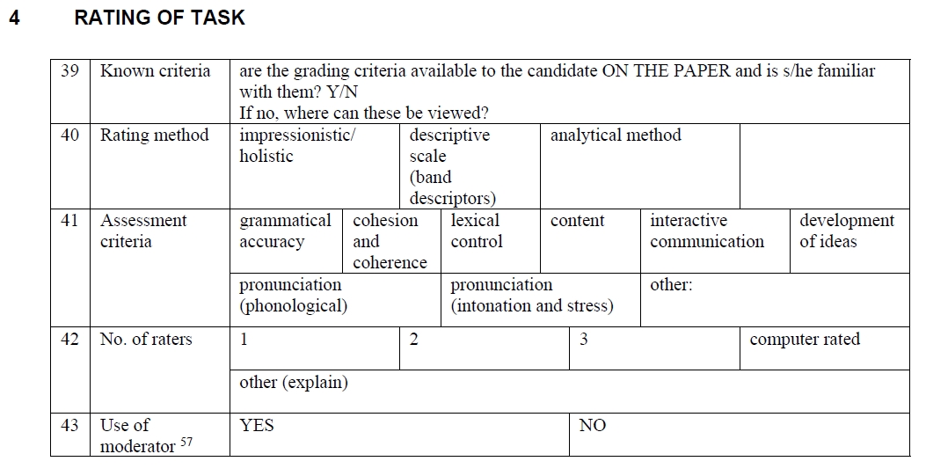
Relating Language Examinations to the Common European Framework of Reference for Languages. A Manual: Speaking

Slide 15
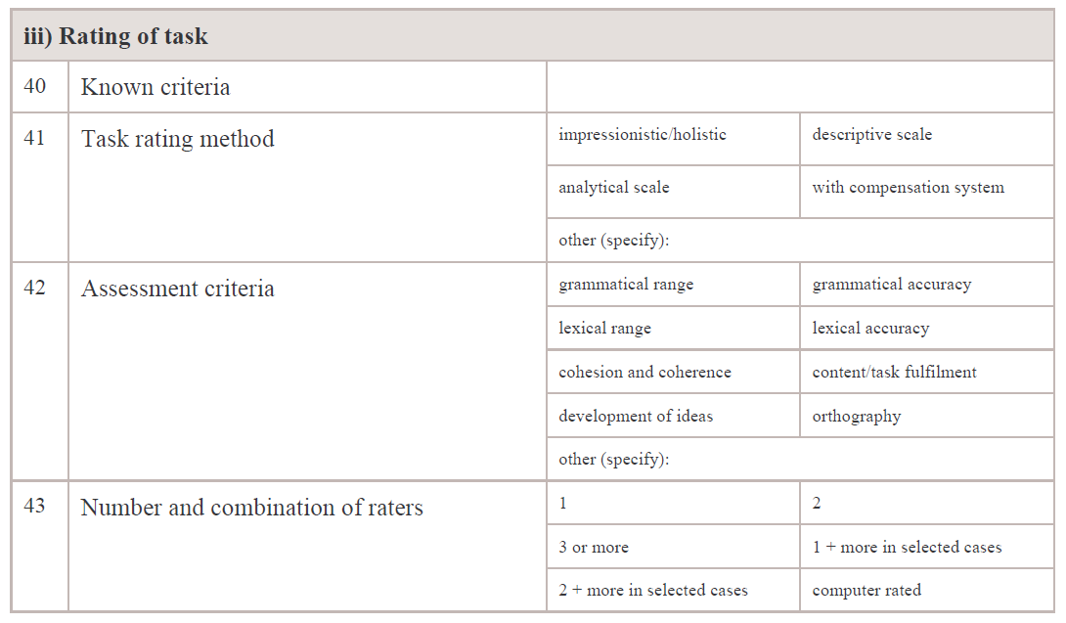
Relating Language Examinations to the Common European Framework of Reference for Languages. A Manual: Writing

Slide 16
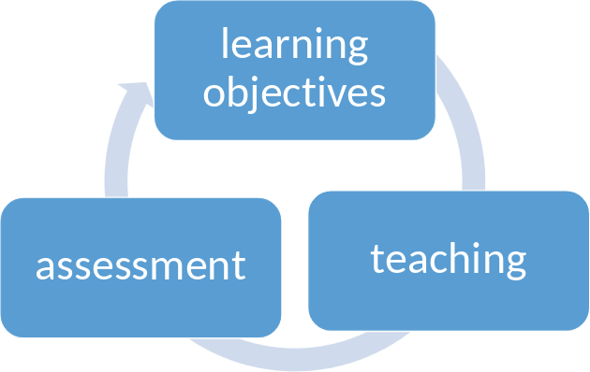
Using the Comp. Vol. to inform our scale
Decide on the type of scale.
Decide on the different criteria: looking at our learning objectives, our syllabus (teaching) and our assessment goals.

Slide 17
Our example: Rating scale for an English for Tourism course - analytic scale for reading into writing activities
Objectives
General objectives: train people that will work in the tourism industry and should be able to communicate in English with an audience of diverse linguistic background, able to deal with problems and facilitate communication (B2 CEFR).
Objectives for reading into writing: able to read information in English and transmit it in writing, facilitating the language for an audience of diverse linguistic background.

Slide 18
Our example: Rating scale for an English for Tourism course - analytic scale for reading into writing activities
Teaching
Teaching: teaching through scenarios, which include vocabulary related to the field of tourism, vocabulary related to business English, reading specialised texts (guides, manuals, maps, listings, charts, etc.), writing formal and informal texts using standard layouts in the field (e-mails, booking forms, memos, notices, etc.), selecting information from text to construct a text (spoken or written), adopting a professional role, displaying courtesy, politeness and formality, communicating with clients, facilitating the access to information (streamlining texts), adapting language, dealing with disputes and misunderstandings, etc.
Teaching activities for reading into writing: reading specialised texts and transmitting them to an audience with diverse linguistic background and uneven proficiency levels of English, writing formal and informal emails related to information attached, etc

Slide 19
Our example: Rating scale for an English for Tourism course - analytic scale for reading into writing activities
Assessment
Task-based or scenario based assessment. These are some examples of tasks that people working in the tourism industry might need to carry out: responding to email inquiries, reading industry reports to understand customer demands or create brochures or tour packages, reading operational or hospitality guidelines to communicate expectations to staff, etc.

Slide 20
Parent task and sub-tasks required and possible CV-CEFR scales
Understanding a text (reading a tourist brochure for example)
Reading for information and argument
Reading for orientation
Reading instructions
Writing a text in which the arguments read are integrated and reused (explaining the brochure in an email for example)
Processing text
Relaying specific information
Streamlining a text
Achieving the communicative goal (communicating the message to our intented audience for example)
Overall written interaction
Correspondence
Grammatical accuracy
Vocabulary control
Sociolinguistic appropriateness
Thematic development

Slide 21
Decide on the criteria based on our goals and teaching methods
Comprehension of the text and reutilisation of arguments | Grammatical accuracy and vocabulary control | Thematic development | Achievement of the communicative purpose
Reading comprehension Processing and streamlining text | Use of grammar and knowledge of vocabulary | Expressing ideas coherently | Completing the task and producing an effect on the reader

Slide 22
Adapting the descriptors to suit our needs
Comprehension of the text and reutilisation of arguments | Grammatical accuracy and vocabulary control | Thematic development | Achievement of the communicative purpose
Description of what the performance of the average learner should be at this level in terms of comprehension of the text and reutilisation of arguments | Description of what the performance of the average learner should be at this level in terms of comprehension of grammatical accuracy and vocabulary control | Description of what the performance of the average learner should be at this level in terms of thematic development | Description of what the performance of the average learner should be at this level in terms of achievement of the communicative purpose

Slide 23
Qualitative validation of our scale
Collect student performances
Separate the performances into groups (very good, good, average, below average, etc)
Identify the common characteristics of the performances in each of the groups in the criteria defined for our scale
Pair the characteristics found with the descriptors in our scale, are the descriptors in our scale represented in the performances?
Refine the descriptors

Slide 24
Quantitative validation of our scale
Linacre J.M. (1994). Many-Facet Rasch Measurement, 2nd Ed. MESA Press
Eckes, T. (2009). Introduction to Many-facet Rasch measurement. Peter Lang

Slide 25
Bibliography
Barkaoui, Khaled. (2010). Explaining ESL essay holistic scores: A multilevel modeling approach. Language Testing, 27(4), 515–535.
Knoch, U. (2009). Diagnostic assessment of writing: A comparison of two rating scales. Language Testing, 26(2), 275–304.
Weigle, S. C. (1994). Effects of training on raters of ESL compositions. Language Testing, 11(2), 197–223.
Weigle, S. C. (2002). Assessing Writing. Cambridge University Press.

